Slide 1
UNSUPERVISED LEARNING TO CURATE STUDENT-PROFESSOR RESEARCH PARTNERSHIPS
Zachary Weiss, Guessebeogo Ouedraogo, Swarnima Gawhane, Madeline Koenig, A.J. Koenig
ISyE 602 - Data Science for People
Notes:
Zach

Slide 2
Purpose
Model aims to serve as a central repository consolidating all information for ongoing research
Gives students an insight into research areas as well as the professors
Suggests allied topics, based on the input keyword
Notes:
Zach

Slide 3
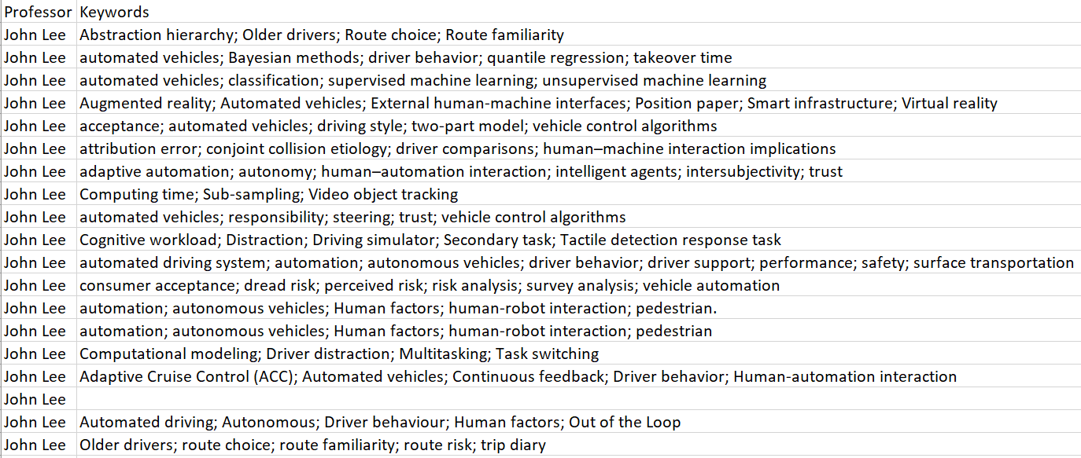
Data Collection
22 faculty members - ISyE, ME, BME
Scopus query search
Notes:
Zach

Slide 4
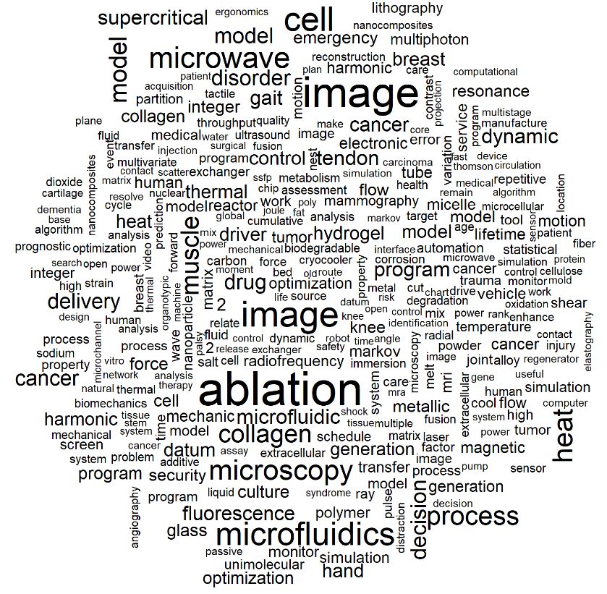
Global Visualization Technique
Notes:
Swarnima

Slide 5
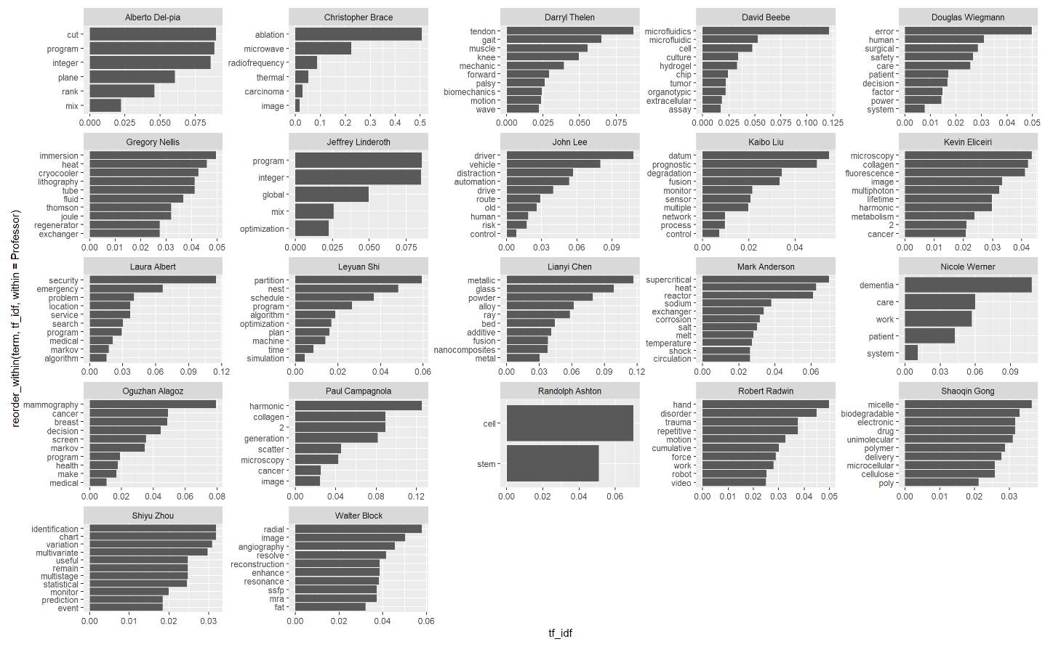
Significant Terms By Professor
Notes:
Swarnima

Slide 6
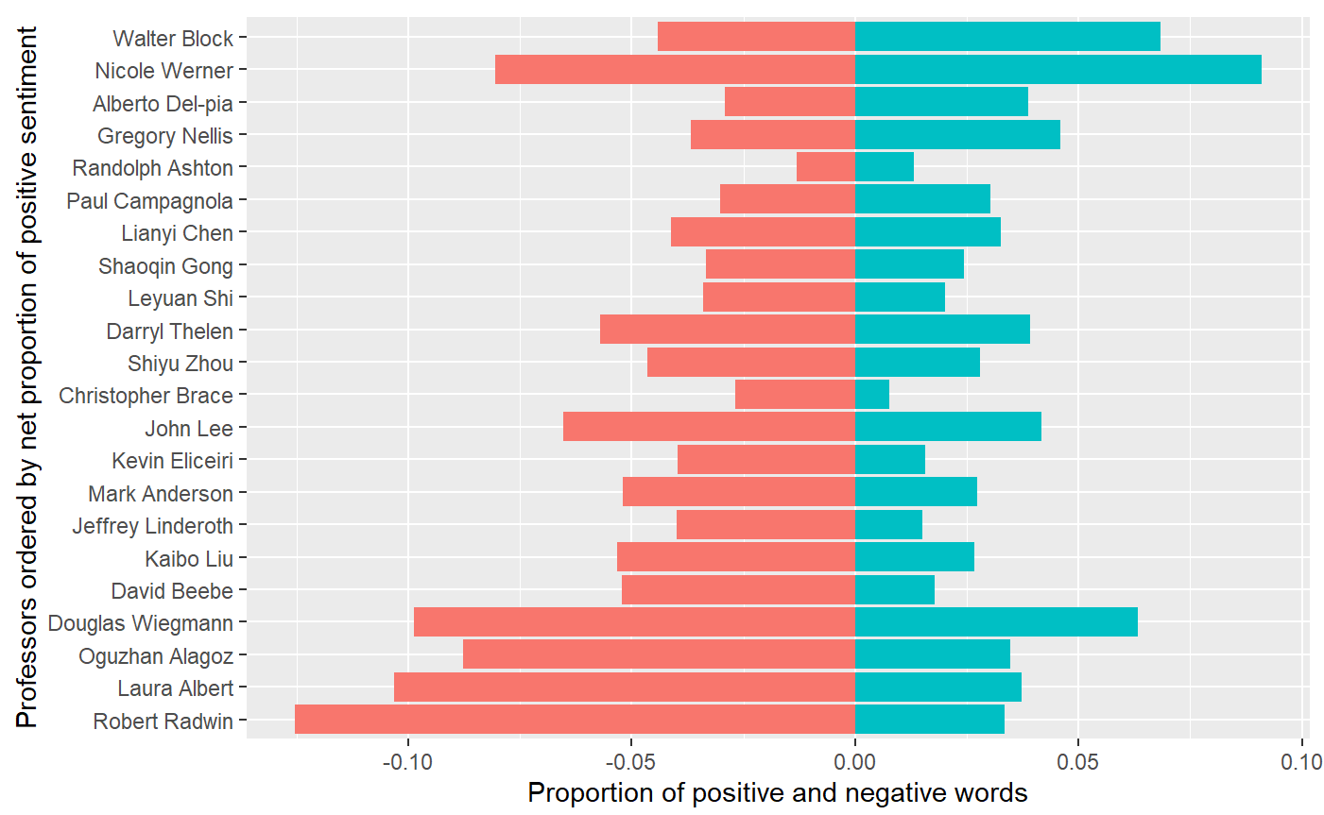
Bing Sentiment Analysis
Notes:
Swarnima

Slide 7
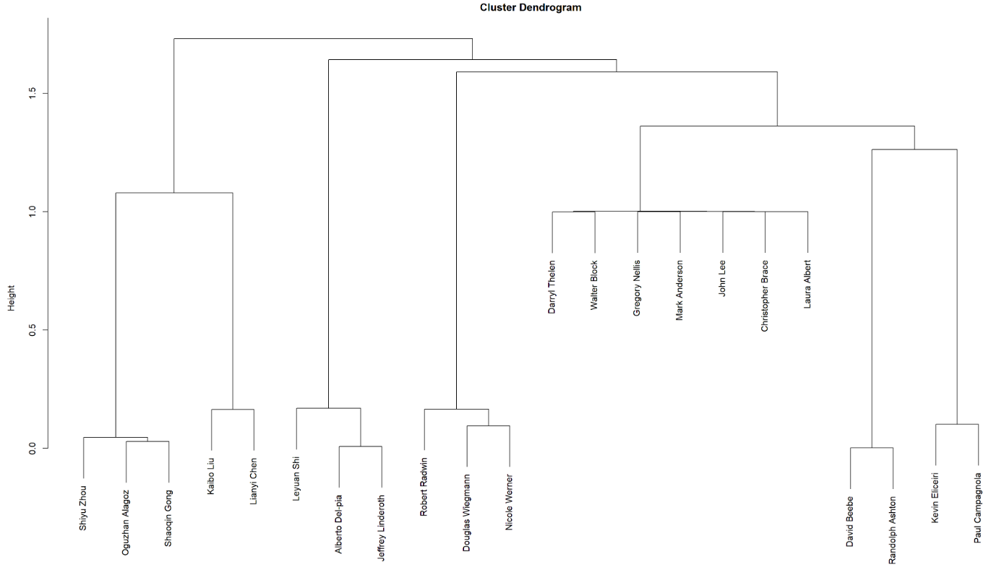
LSA Dendrogram
Notes:
Madeline

Slide 8
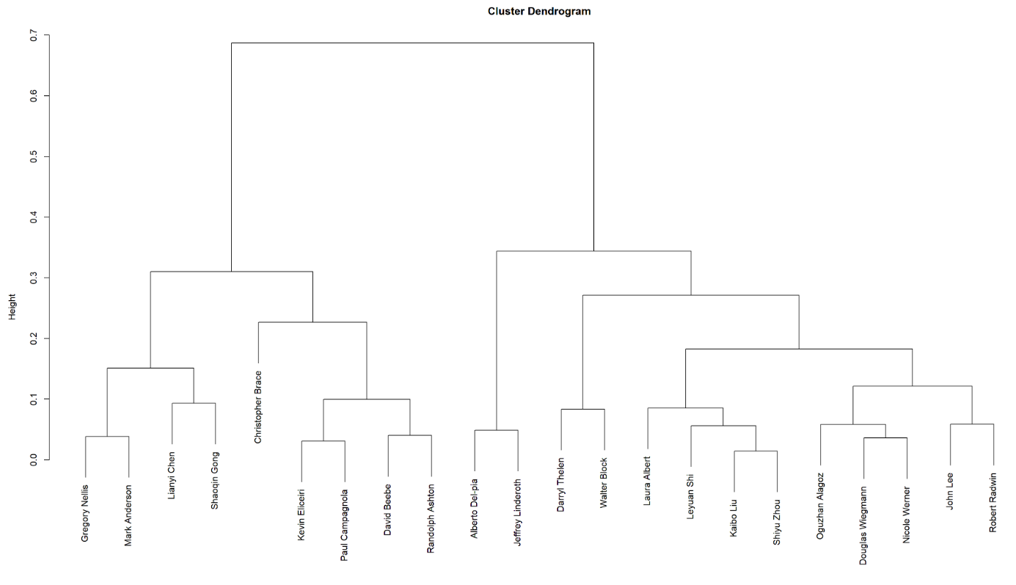
Glove Dendrogram
Notes:
Madeline

Slide 9
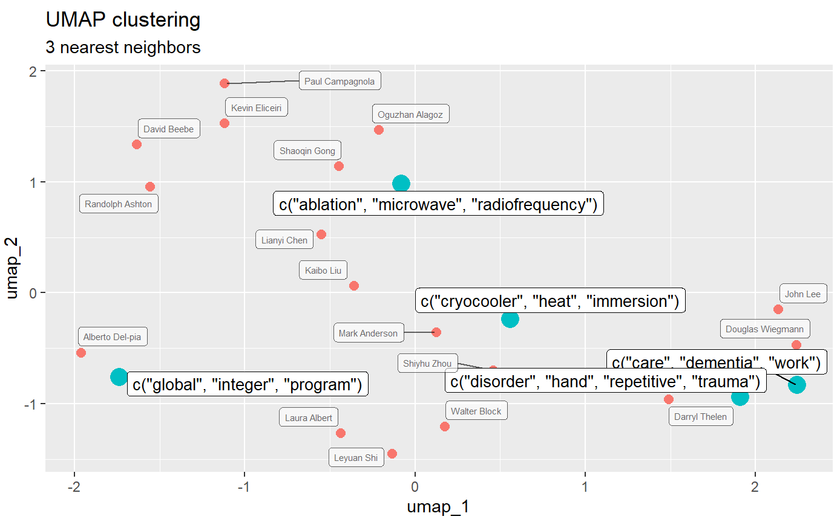
Local Visualization Technique
Notes:
Madeline

Slide 10
Implementation
What research topic are you interested in?
Need some inspiration?
Education
Psychology
Manufacturing
Need some inspiration?
Machining
Optimization
Supply Chain
Education
Psychology
Manufacturing
Material Flow
Programming
Efficiency
Notes:
A.J.

Slide 11
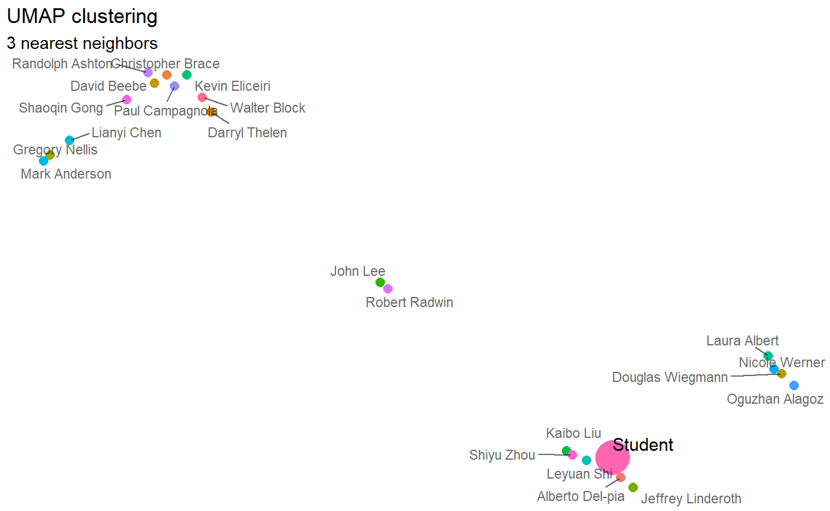
Student Projection
Manufacturing, Optimization, Efficiency
Notes:
Madeline/Abdy

Slide 12
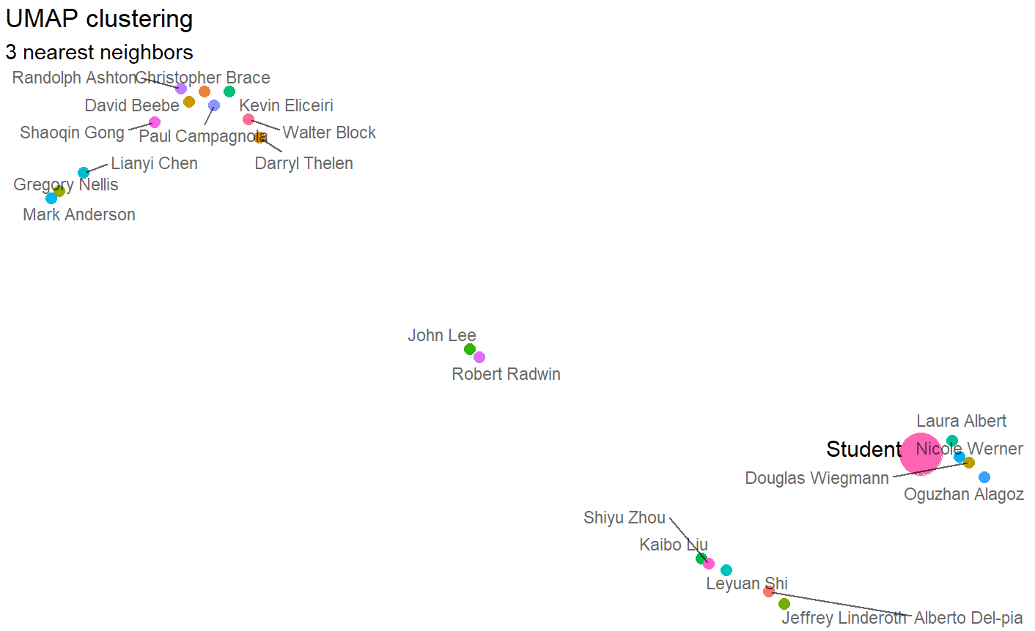
Student Projection
Medical, Human, Caregiving
Notes:
Abdy

Slide 13
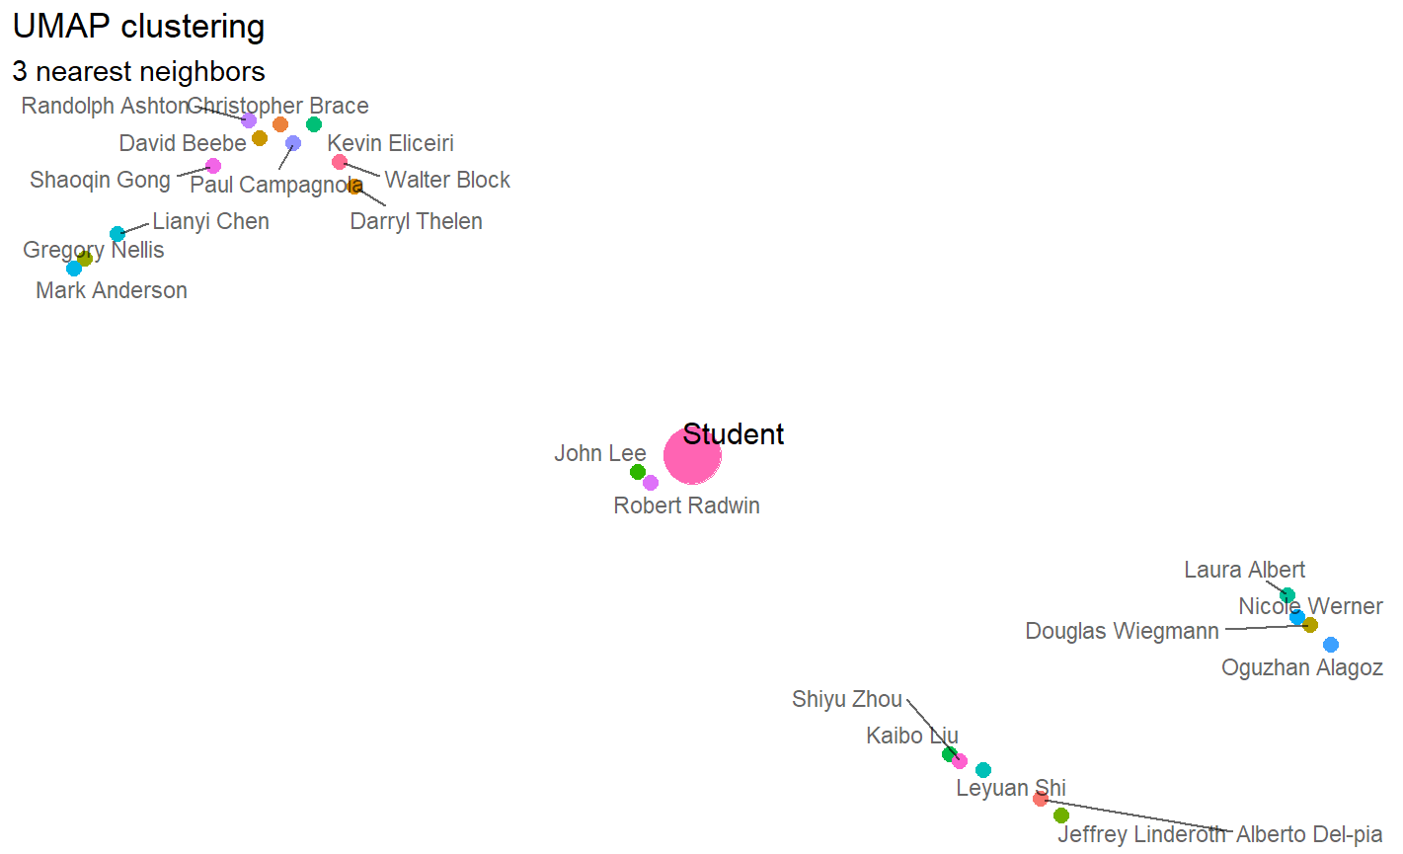
Student Projection
Automation, Trust, Vehicle
Notes:
Abdy

Slide 14
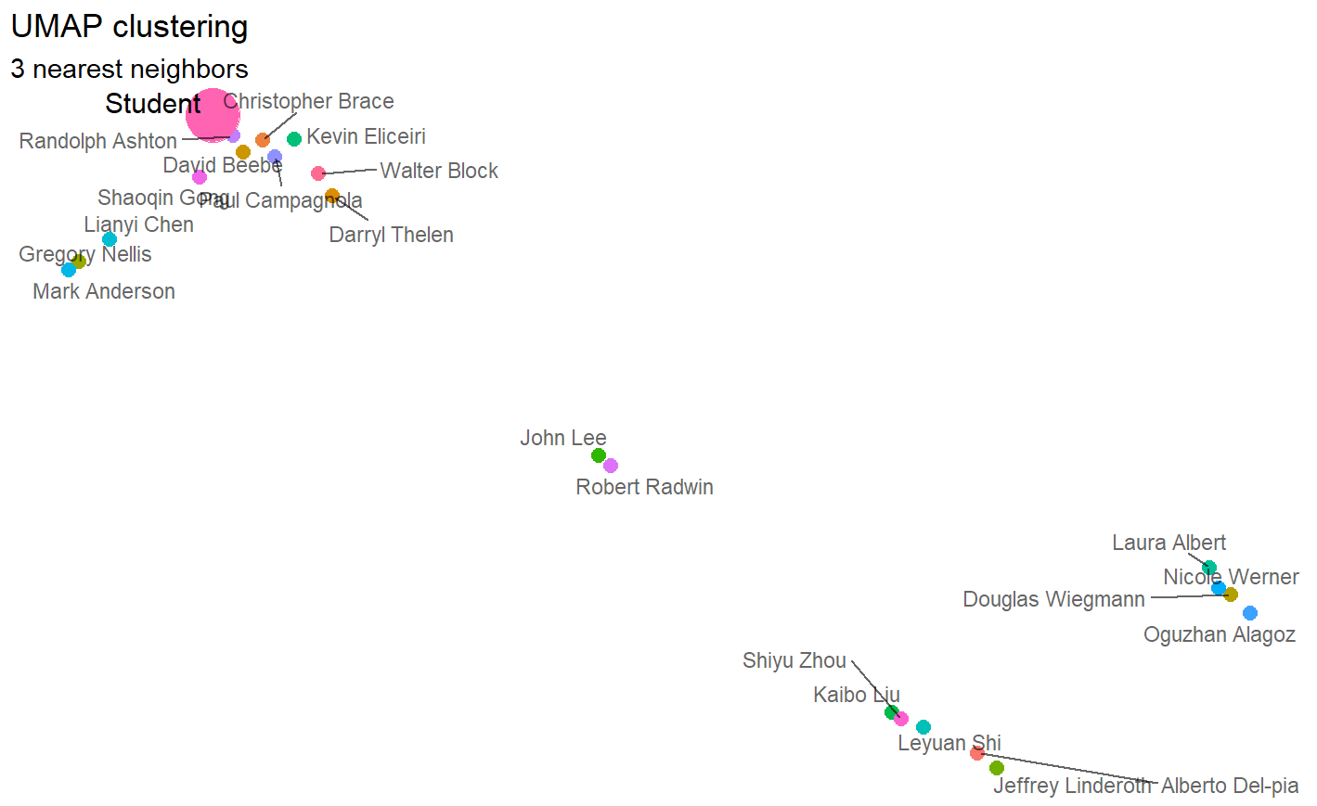
Student Projection
Tissue, Cell, Biology

Slide 15
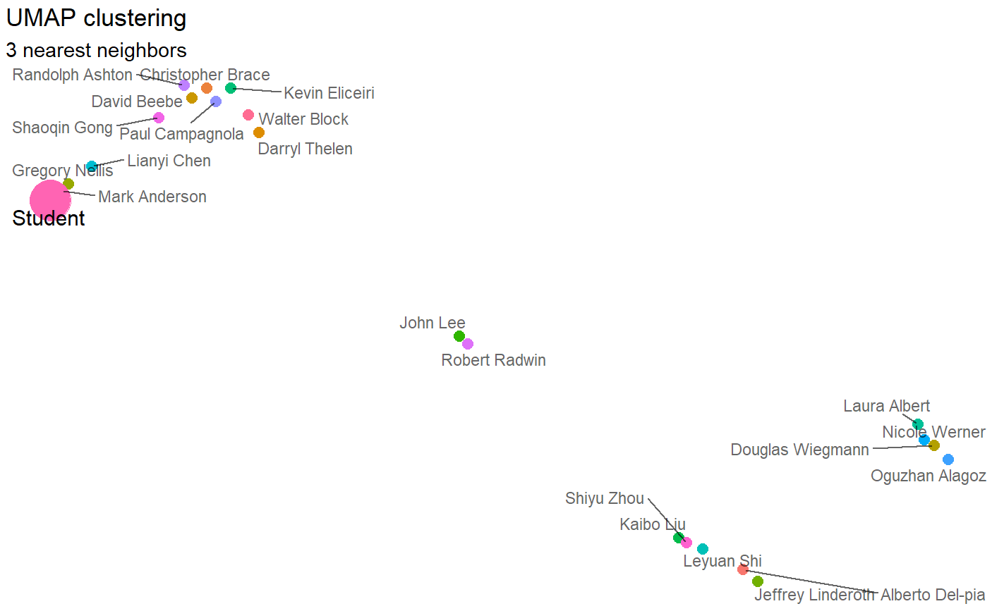
Student Projection
Solar, Nuclear, Energy

Slide 16
Future Recommendations
Improving visual design
Adding in a larger database of professors and research
Partnering with universities to set up a larger network
Testing more student inputs to guarantee proper matches
Notes:
Zach

